Slide 1

BERINYUY BERTRAND
MAINIMO
01/01/2023

Slide 2

Outline
• Executive Summary
• Introduction
• Methodology
• Results
• Conclusion
• References
• Appendix
2

Slide 3
Executive Summary
This capstone project is all about predicting if the SpaceX Falcon 9 first stage will land successfully.
If we can determine if the first stage will land, we can determine the cost of a launch. This will be
achieved with the use of different data science procedures.
• Summary of methodologies
-
-
-
-
-
-
-
Data Collection with the help of an API
Data Collection using Web Scraping
Data Wrangling
Exploratory Data Analysis using SQL
Exploratory Data Analysis using Data Visualization processes
Interactive Visual Analytics using Folium
Machine Learning Prediction
• Summary of all results
-
-
-
Results of Exploratory Data Analysis
Screenshots presenting interactive analytics
Results of the Predictive Analytics
3

Slide 4
Introduction
• Project background and context
The main aim of this Data Science project is to allow the company to compete with SpaceX. In order to
achieve this goal, it is important to determine if the first stage of the SpaceX Falcon 9 rocket will land
successfully.
SpaceX advertises Falcon 9 rocket launches on its website, with a cost of 62 million dollars. Other providers
cost upward of 165 million dollars each, much of the savings is because SpaceX can reuse the first stage.
• Problems you want to find answers
Therefore if we can accurately predict the likelihood of the first stage rocket landing successfully, w hat
factors determine if the rocket will land successfully, the interaction amongst various features that determine
the success rate of a successful landing, what operating conditions needs to be in place to ensure a successful
landing program, then we can determine the cost of a launch. With the help of the Data Science findings and
models, the company can make more informed bids against SpaceX for a rocket launch.
4

Slide 5

Section 1
5

Slide 6

Methodology
Executive Summary
• Data collection methodology:
• Make requests to the SpaceX API.
• Perform web scraping to collect Falcon 9 historical launch records on the Wikipedia page titled: List of
Falcon 9 and Falcon Heavy launches
• Perform data wrangling
• Clean the data and explore it to find patterns in the data to determine the labels for training supervised
models.
• Perform exploratory data analysis (EDA) using visualization and SQL
• Perform interactive visual analytics using Folium and Plotly Dash
• Perform predictive analysis using classification models
• Create a machine learning pipeline to predict if the first stage will land given the data.
6
• Train the best performing model to make accurate predictions.

Slide 7
Data Collection
The data was collected using various methods
- Data collection was done using get request to the SpaceX API.
- Next, we decoded the response content as a Json using .json() function call and turn it into a
pandas dataframe using .json_normalize().
- We then cleaned the data, checked for missing values and fill in missing values where necessary.
- In addition, we performed web scraping from Wikipedia for Falcon 9 launch records with
BeautifulSoup.
- The objective was to extract the launch records as HTML table, parse the table and convert it to a
pandas dataframe for future analysis.
7

Slide 8

Data Collection – SpaceX API
• Make a request to SpaceX API
Make request to
SpaceX API
Decode the response
content as a Json
Turn Json into pandas
data frame
and make sure the data is in the
correct format.
• Perform some basic data
wrangling and formatting in order
to clean the requested data.
Use the API again to
get information about
the launches using
the IDs given for each
launch
Filter the dataframe to
only include Falcon
9 launches
Construct our dataset
using the data we have
obtained
• Convert our data frame into a
CSV dataset.
• URL link: spacex-data-collection-api
Replace null values in the
data with the mean that
was calculated
Convert data frame into a
CSV dataset
8

Slide 9
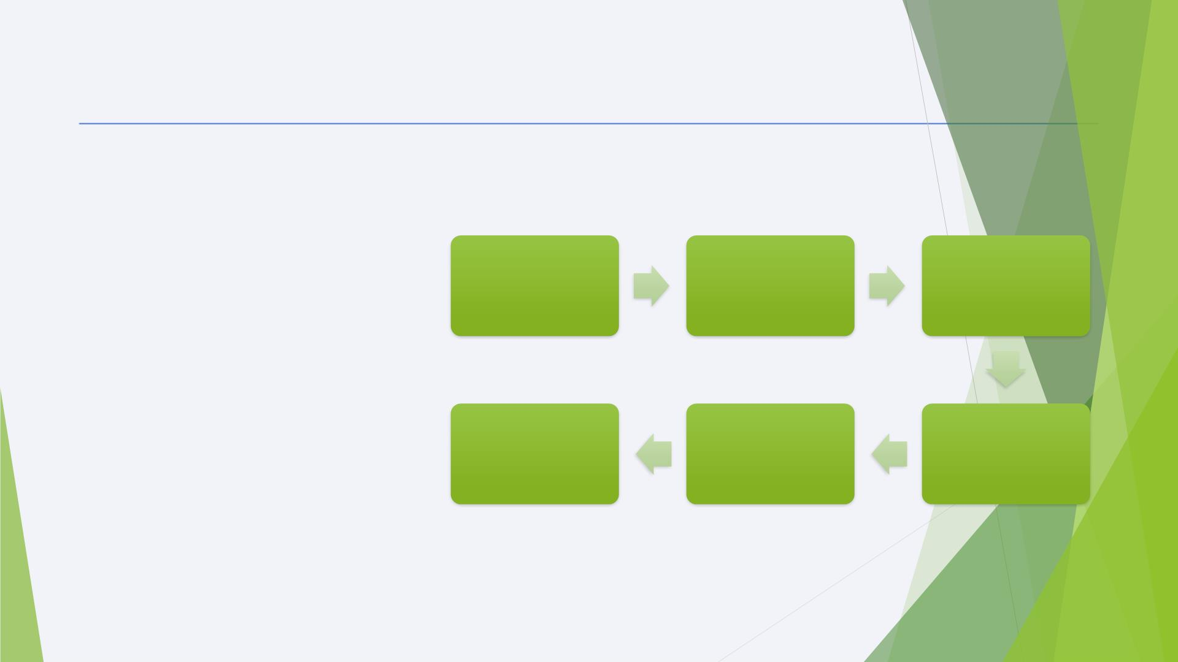
Data Collection - Scraping
◆ Data Collection BY Web Scraping
process is given in flow chart for an
overview. For Completed Notebook link
given below
Request the Falcon9
Launch Wiki page
from its URL
Create
a BeautifulSoup object
from the
Extract all
column/variable
names from the HTML
table header
◆ • Git Hub URL link: Web scraping Falcon
9 and Falcon Heavy Launches Records
from Wikipedia
HTML respone
Fill up
the dictionary with
launch records
extracted from table
rows.
Create an empty
dictionary with keys
from the extracted
column names
Convert the dictionary
into a CSV dataset
9

Slide 10

Data Wrangling
In the data set, there are several different cases where
Determine the number of launches on each facility
Calculate the number and occurrences of each orbit
the booster did not land successfully. Sometimes a landing was
attempted but failed due to an accident; for example, True
Ocean means the mission outcome was successfully landed
to a specific region of the ocean while False Ocean means
the mission outcome was unsuccessfully landed to a specific
region of the ocean. True RTLS means the mission outcome
was successfully landed to a ground pad False RTLS means
the mission outcome was unsuccessfully landed to a ground
pad.True ASDS means the mission outcome was successfully
landed on a drone ship False ASDS means the mission
outcome was unsuccessfully landed on a drone ship.
Calculate the number and occurences of mission outcome per orbit type
Create a landing outcome training label and loop through all the landing
outcomes
Create a "Class" column containing the information from the outcome label
I mainly convert those outcomes into Training Labels
with “1” means the booster successfully landed, “0” means it
was unsuccessful.
Transform the data frame into a CSV dataset.
10

Slide 11
EDA with Data Visualization
Data visualization helps us understand data by curating it into a form that’s
easier to understand, highlighting the trends and outliers. Several types of
charts were used in the visualization of the data:
• Cat plots and scatter plots were used to view the relationships of
categorical variables like Launch Site and Orbit.
• A bar chart was used to visualize the success rate of each orbit type.
• A line chart was used to visualize the launch success yearly trend.
URL link: eda-dataviz
11

Slide 12
EDA with SQL
Summary of SQL queries that were used:
• Display the names of the unique launch sites in the space mission
• Compare the payload mass with boosters launched by NASA (CRS)
• Display average payload mass carried by booster version F9 v1.1
• List the total number of successful and failure mission outcomes
• Determine the dates of different landing outcomes
URL link: EDA - SQL
12

Slide 13
Build an Interactive Map with Folium
Markers of all Launch Sites:
- Added Marker with Circle, Popup Label and Text Label of NASA Johnson Space Center using
its latitude and longitude coordinates as a start location.
- Added Markers with Circle, Popup Label and Text Label of all Launch Sites using their latitude
and longitude coordinates to show their geographical locations and proximity to Equator and
coasts.
Coloured Markers of the launch outcomes for each Launch Site:
- Added coloured Markers of success (Green) and failed (Red) launches using Marker Cluster to
identify which launch sites have relatively high success rates.
Distances between a Launch Site to its proximities:
- Added coloured Lines to show distances between the Launch Site KSC LC-39A (as an
example) and its proximities like Railway, Highway, Coastline and Closest City.
◆ GitHub URL (Notebook ): Notebook Interactive Map with Folium
13
◆ Google colab URL: Google colab Notebook Interactive Map with Folium (use this link for the maps to load)

Slide 14
Build a Dashboard with Plotly Dash
Launch Sites Dropdown List:
- Added a dropdown list to enable Launch Site selection.
Pie Chart showing Success Launches (All Sites/Certain Site):
- Added a pie chart to show the total successful launches count for all sites and the
Success vs. Failed counts for the site, if a specific Launch Site was selected.
Slider of Payload Mass Range:
- Added a slider to select Payload range.
Scatter Chart of Payload Mass vs. Success Rate for the diﬀerent Booster Versions:
- Added a scatter chart to show the correlation between Payload and Launch Success.
◆ GitHub URL: Plotly - Dash
14

Slide 15

Predictive Analysis (Classification)
Scikit-learn is the primary ML(machine learning) library
that was used for predictive analysis. The following took
place:
Create a column for
Split data into
training data and
test data
the class
Standardize the data
◆ Created a machine learning pipeline to predict if the
first stage will land given the data.
Calculate the
accuracy on the test
data
Create a
GridSearchCV object
and fit different ML
objects.
Choose the best ML
method
◆ Using GridSearchCV, found the best ML method for
predictions.
◆ Compared the predictions with the real labels.
◆ GitHub URL: Predictive Analysis
Compare the
predictions with the
real labels
15

Slide 16
Results
The exploratory data analysis has shown us that successful landing outcomes are somewhat
correlated with flight number. It was also apparent that successful landing outcomes have had
a significant increase since the year 2015.
All launch sites are located near the coast line. Perhaps, this makes it easier to test rocket
landings in the water.
Furthermore, the sites are also located near highways and railways. This may facilitate
transportation of equipment and research material.
The machine learning models that were built, were able to predict the landing success of
rockets with an accuracy score of 83.33%. This accuracy can be increased in future projects
with more data.
16

Slide 17

Section 2

Slide 18
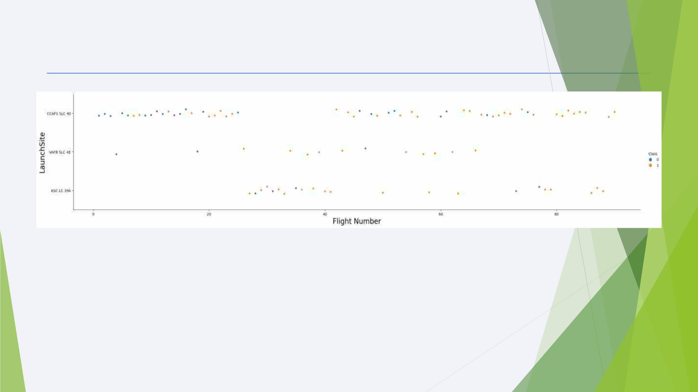
Flight Number vs. Launch Site
From the plot, it appears that there were more successful landings as the flight numbers increased. It
also seems that launch site CCAFS SLC 40 had the most number of landing attempts while the
site VAFB SLC 4E had the least number of attempts.
18

Slide 19
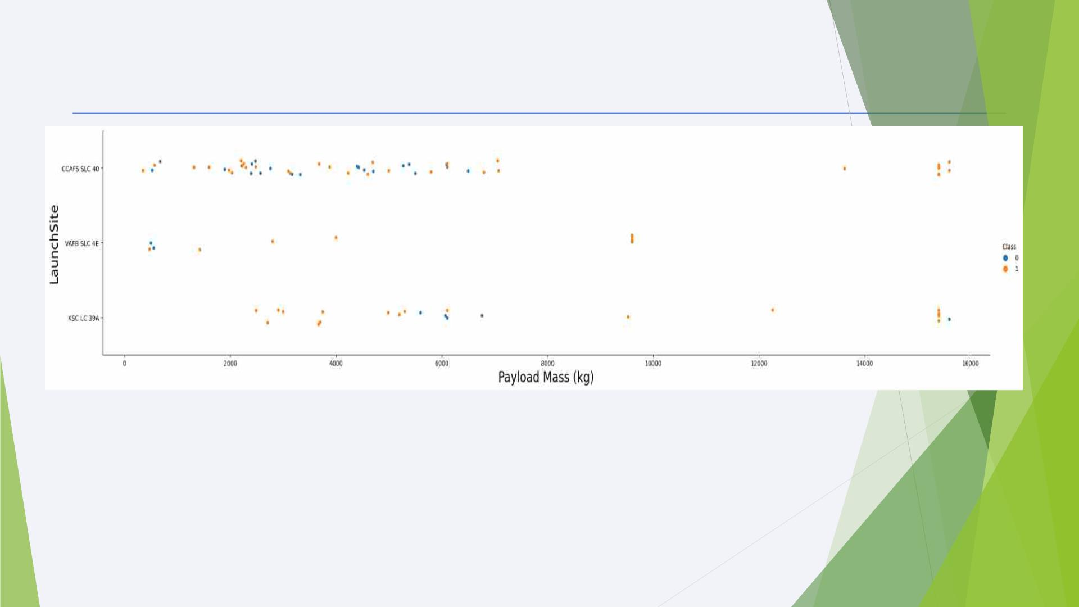
Payload vs. Launch Site
- From the plot as the payload mass increases, the success rate increases as well
- Most of the launches with payload mass over 7000 kg were successful.
19

Slide 20
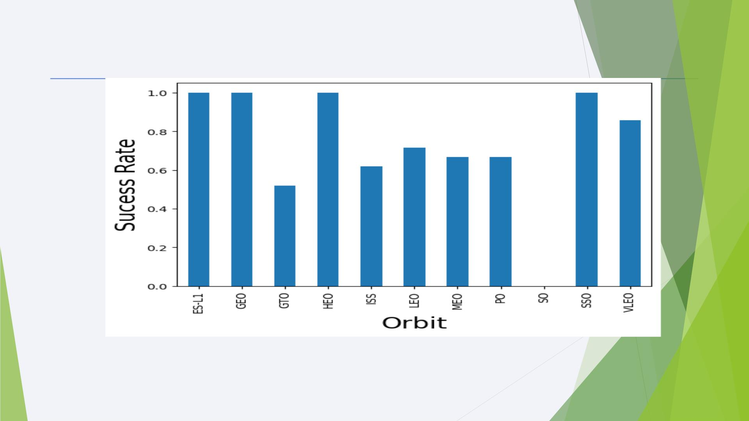
Success Rate vs. Orbit Type
The orbit types SSO, HEO, GEO and ES-L1 had the highest success rate.
20

Slide 21
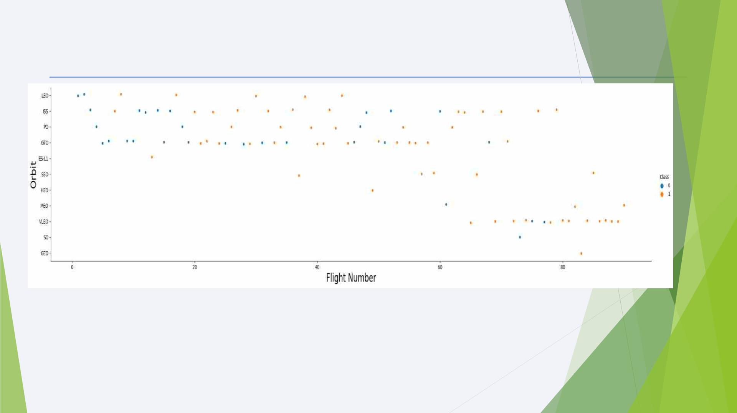
Flight Number vs. Orbit Type
- In the LEO orbit, the success is positively correlated to the number of flights.
- There seems to be no relationship between flight number in the GTO orbit.
21

Slide 22
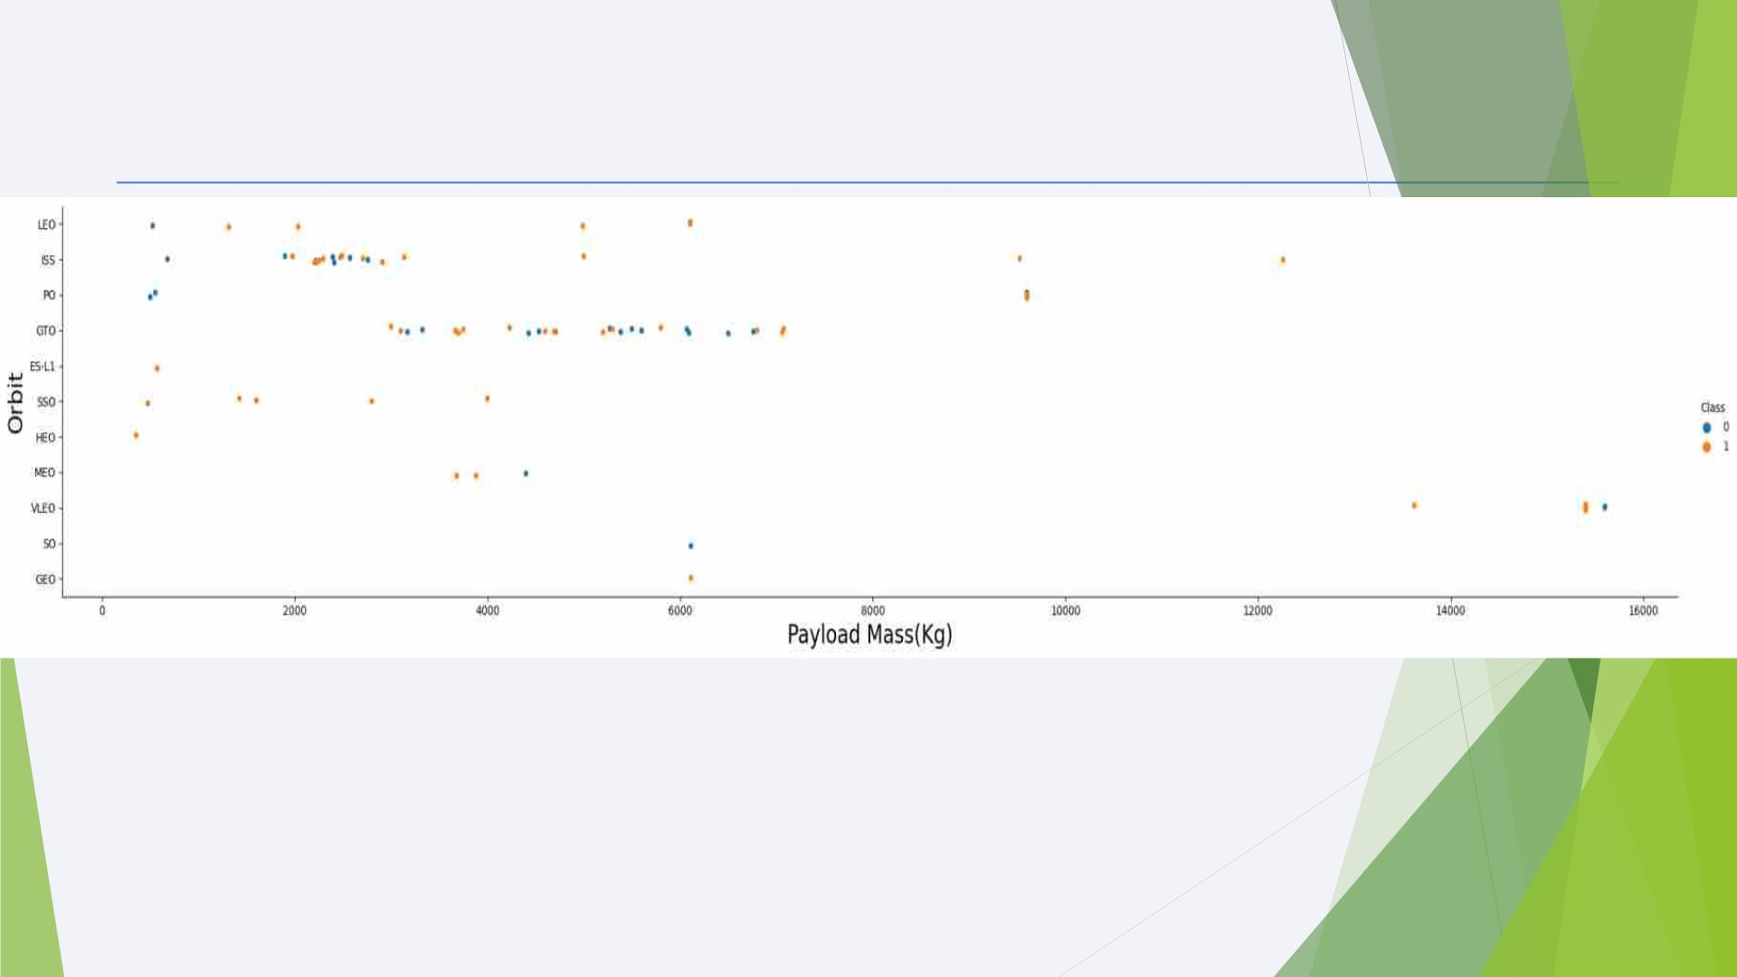
Payload vs. Orbit Type
With heavy payloads the successful landing or positive landing rate are more for
Polar, LEO and ISS.
22

Slide 23
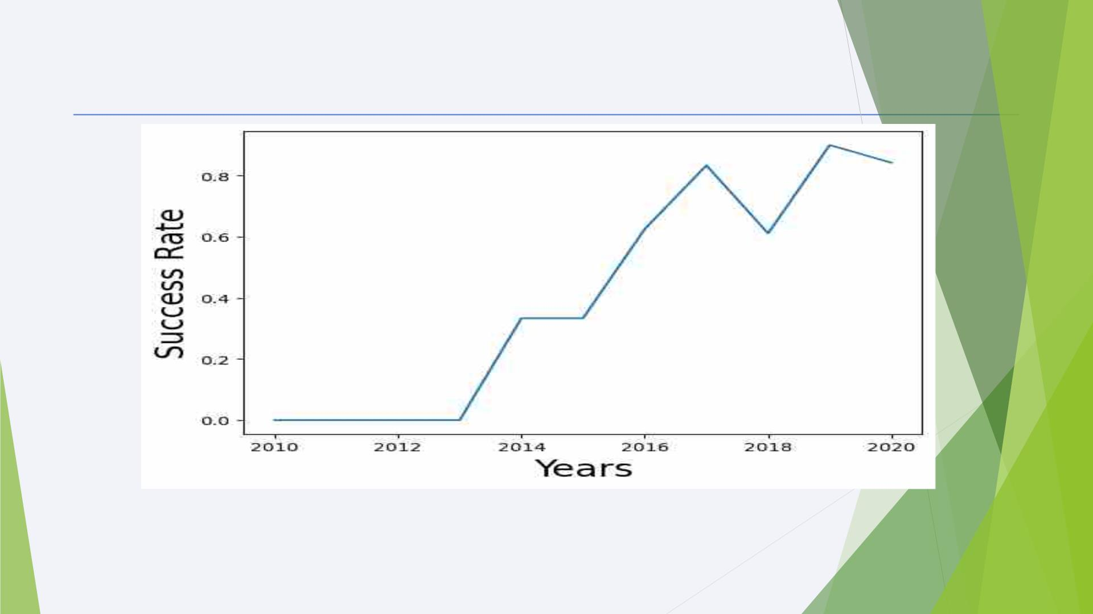
Launch Success Yearly Trend
From the plot, we can observe that success rate since 2013 kept on increasing till 2020.
23

Slide 24
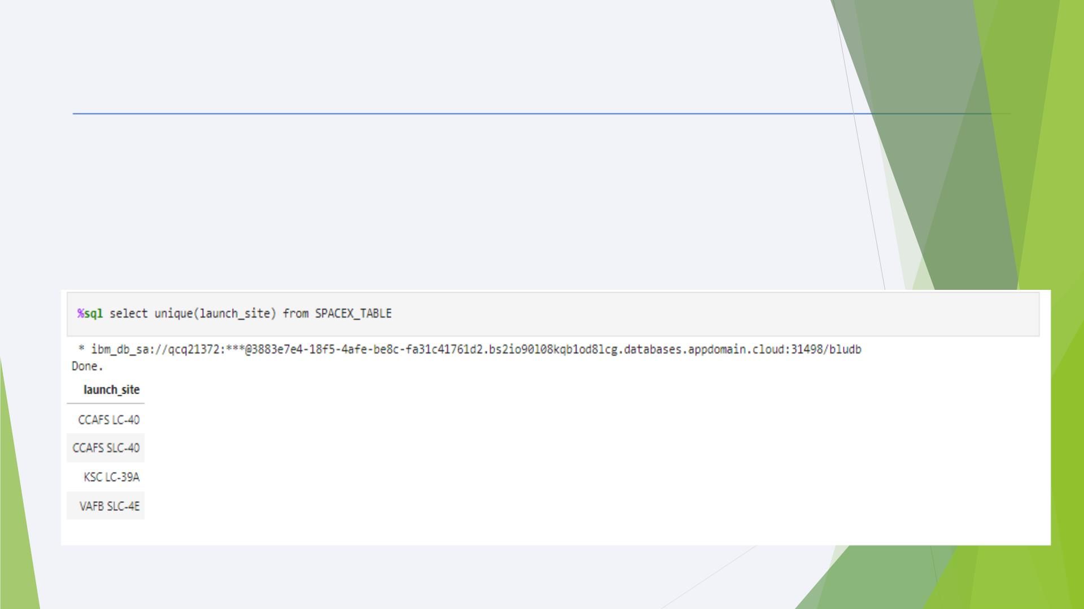
All Launch Site Names
◆ The DISTINCT clause was used to return only the unique rows from the launch_site
column.
◆ The names of the launch sites are CCAFS LC-40, CCAFS SLC-40, KSC LC-39A, VAFB SLC-
4E .
24

Slide 25
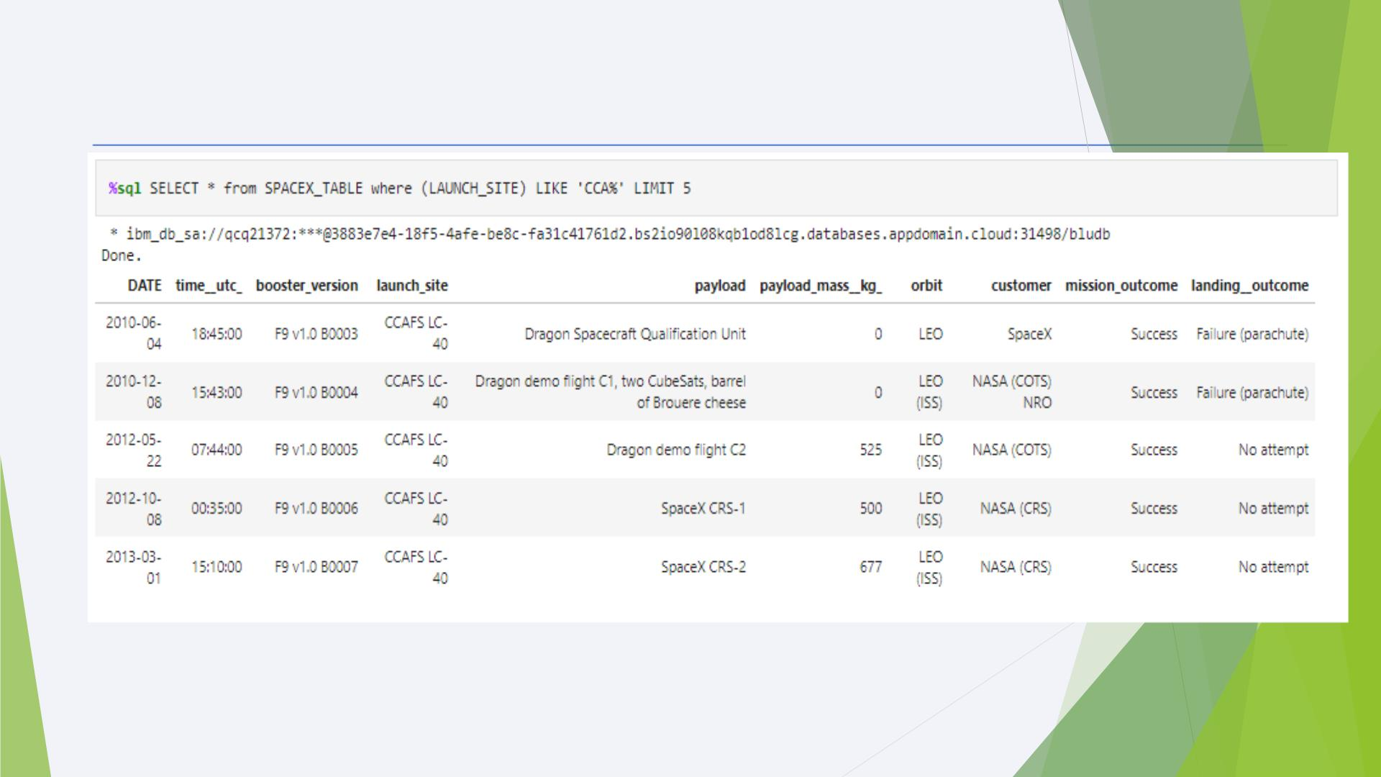
Launch Site Names Begin with 'CCA'
These are 5 records where launch sites begin with the letters 'CCA'. As we can see, there are other
organizations besides SpaceX that were testing their rockets.
25

Slide 26
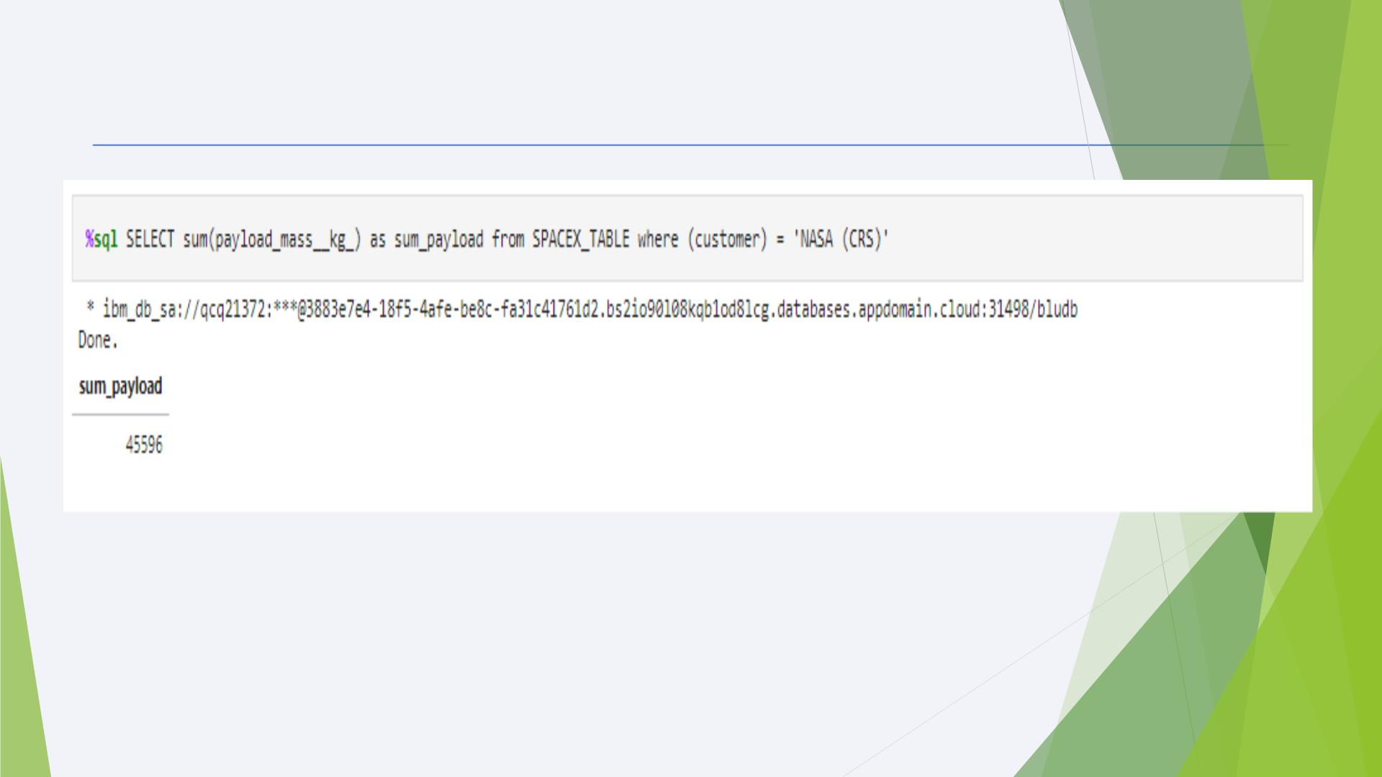
Total Payload Mass
• The information in the table displays the total payload mass carried by boosters launched by
NASA .
• It seems that NASA (CRS) had a significantly higher total payload mass com²p⁶ ared to the rest.

Slide 27
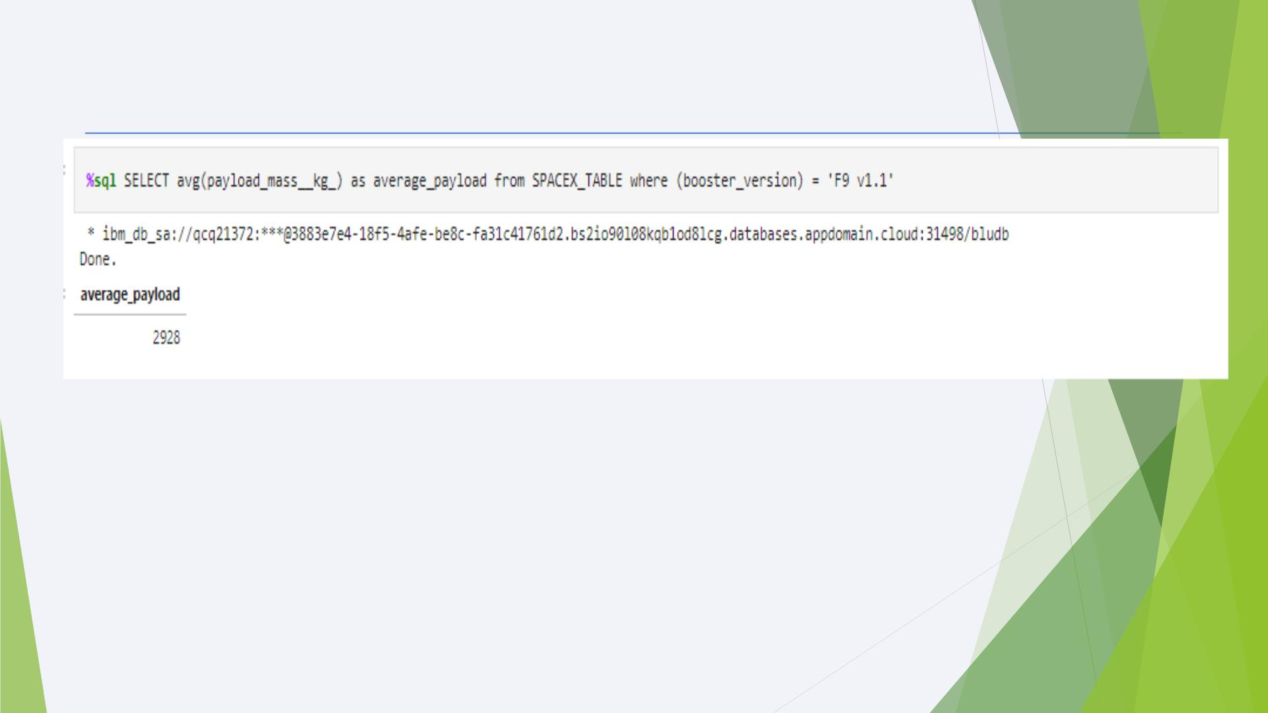
Average Payload Mass by F9 v1.1
◆ The AVG() function was used to the calculate the average payload the average payload mass carried by
booster version F9 v1.1
◆ The WHERE clause was used to filter results so that the calculations were only performed on booster
versions only if they were named “F9 v1.1”
◆ The calculated average payload mass carried by booster version F9 v1.1 is 2928.4
27

Slide 28
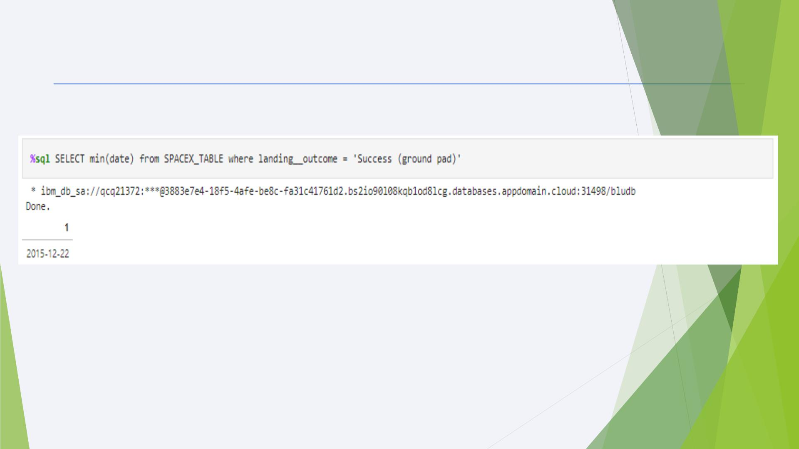
First Successful Ground Landing Date
◆ From the picture given above you can see that the first successful ground pad was in 22 December 2015.
28

Slide 29
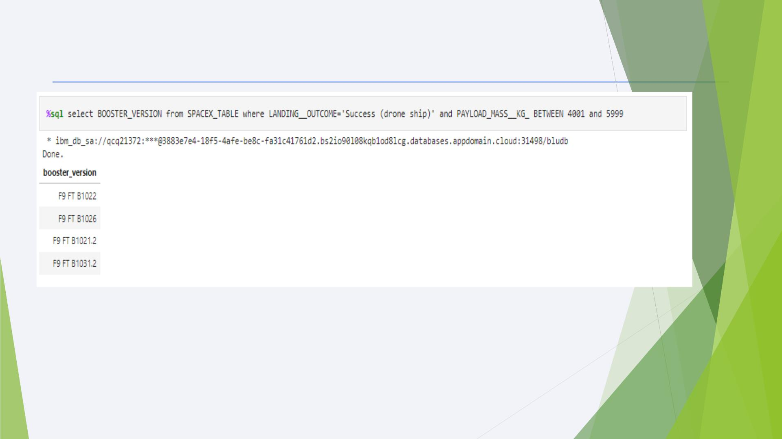
Successful Drone Ship Landing with Payload between 4000 and 6000
◆ Only 4 Boosters with a payload mass between 4000 and 6000 experienced a successful drone
ship landing
◆ It is interesting to see that they all had successful landing outcomes.
29

Slide 30
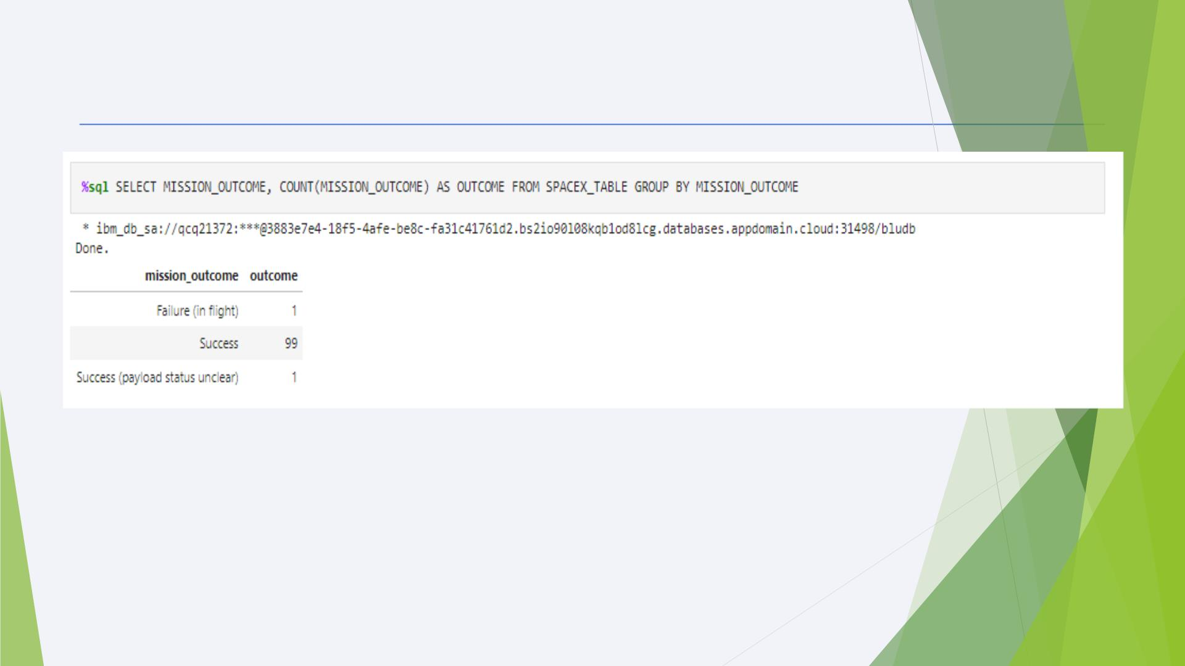
Total Number of Successful and Failure Mission Outcomes
◆ It appears that missions generally tend to be successful with the exception of one
failure.
30

Slide 31
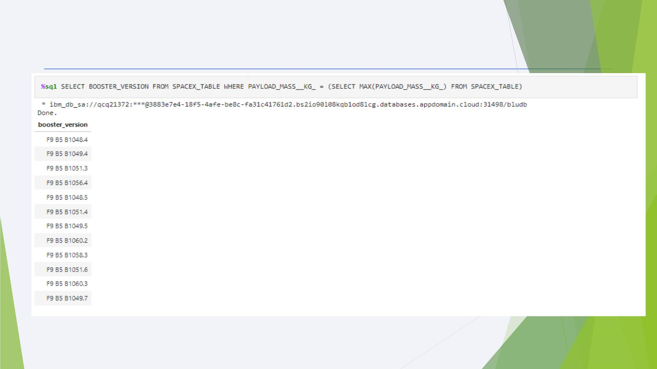
Boosters Carried Maximum Payload
12 boosters have carried the maximum payload mass of 15600 kg.
31

Slide 32
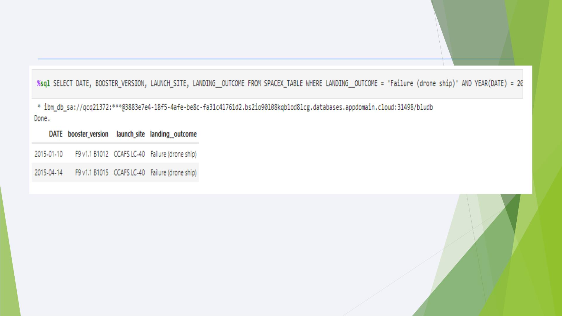
2015 Launch Records
◆ It appears that 2 boosters failed to land at the beginnnig of the year..
◆ The first successful landing took place later that year in December as we saw earlier.
32

Slide 33
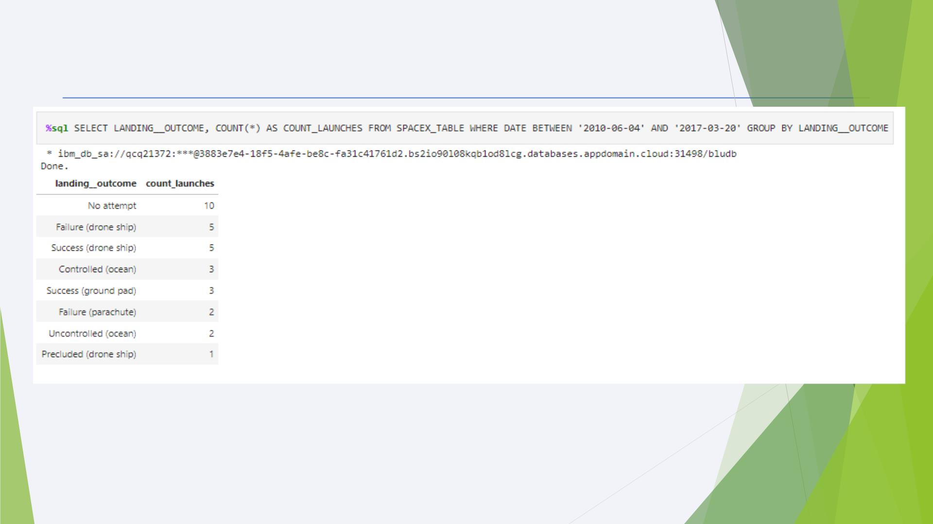
Rank Landing Outcomes Between 2010-06-04 and 2017-03-20
◆ If we observe the table, it is apparent that the number of successful landings have increased
since 2015.
◆ Before 2013, it seems that there were no attempts to land the boosters.
33

Slide 34

Section 3

Slide 35

Launch Site Locations
◆ All launch sites are in very close proximity to the coast, while launching rockets towards the ocean it
minimises the risk of having any debris dropping or exploding near people.
35
◆ Most of Launch sites are in proximity to the Equator line. This is because of inertia. This speed will help
the spacecraft keep up a good enough speed to stay in orbit.

Slide 36
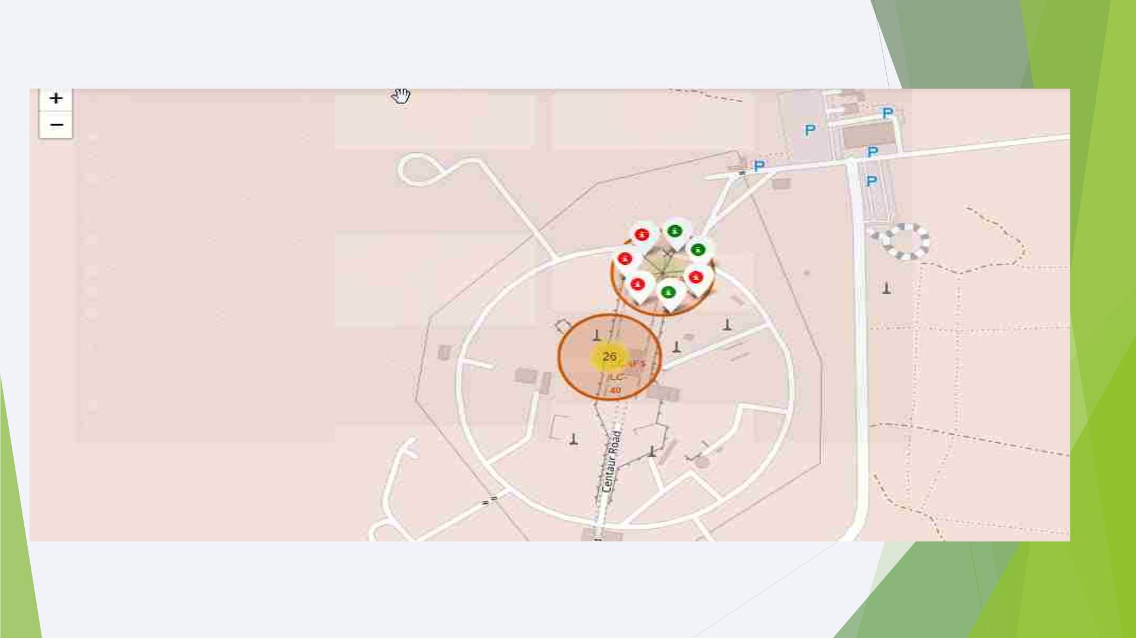
Success vs. Failure Rate of Rocket Launches
Zooming in on a launch site, we can click on the launch site which will display marke₃₆r clusters of successful
landings (green) or failed landing (red).

Slide 37
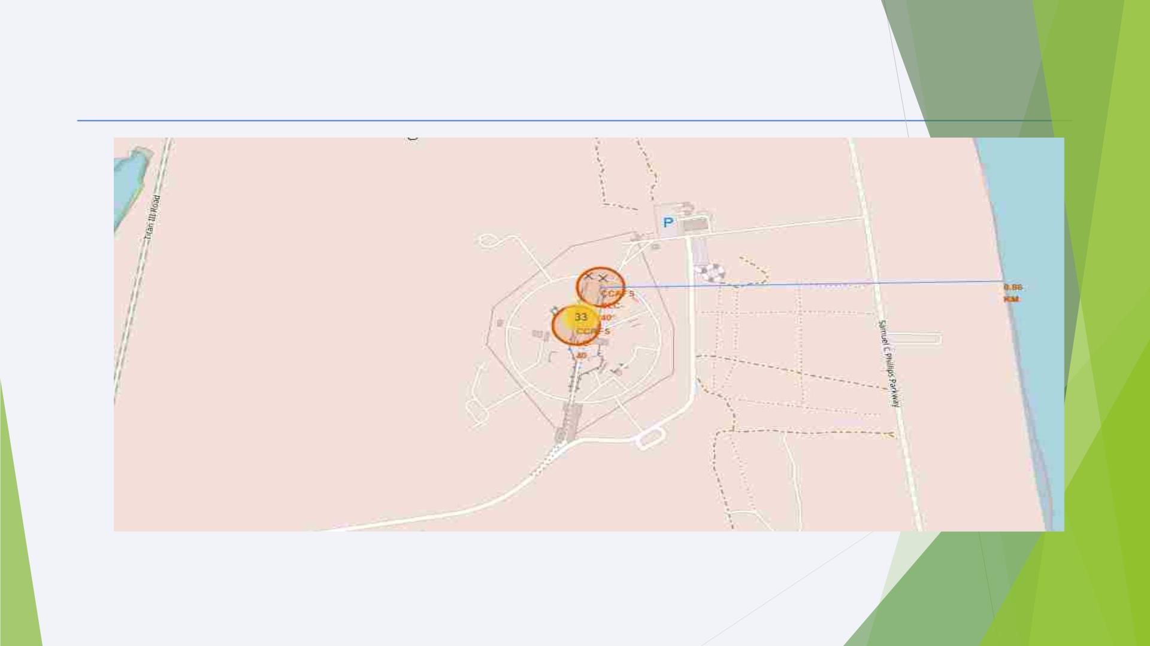
Launch Site Proximities
The sites are close the coast line. This is evident with³⁷ the many
rocket landing tests on water bodies like the ocean.

Slide 38

Section 4

Slide 39
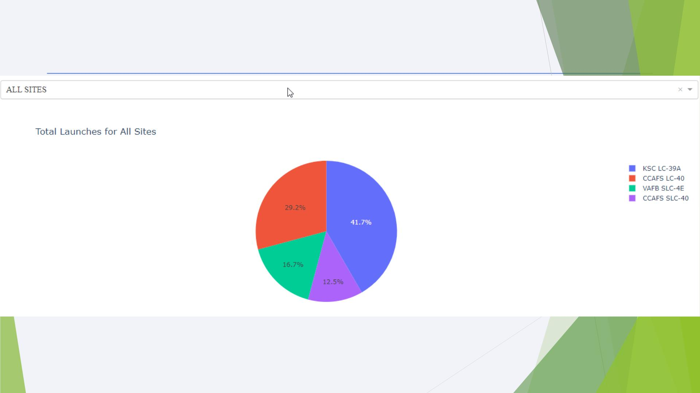
<Dashboard Screenshot 1>
The chart clearly shows that from all the sites, KSC LC-39A has the most suc₃c₉ essful launches

Slide 40
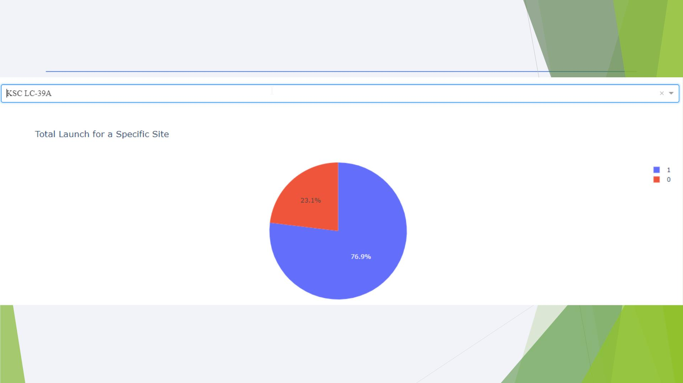
Pie chart showing the Launch site with the highest launch success
ratio
The chart shows that 76.9% of the total launches at site KSC LC-39A were successful.₄₀This is a the highest success
rate of all the different launch sites.

Slide 41
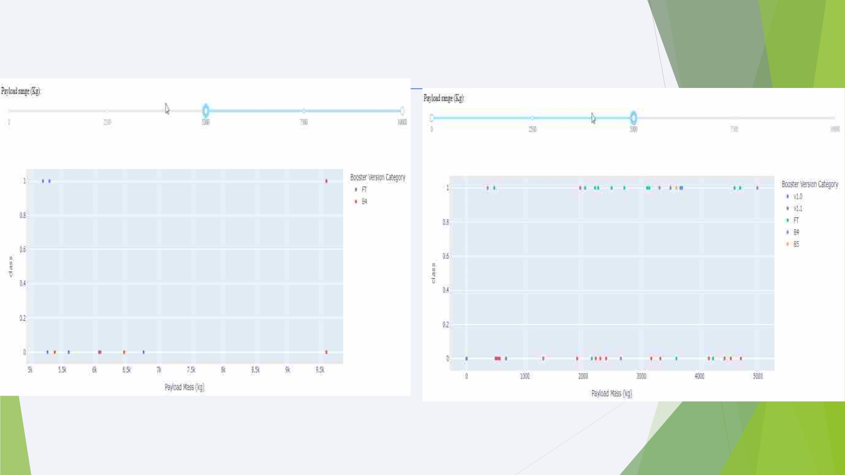
Payload vs. Launch Outcome for All Sites
More booster versions acquire a success rate at lower payloads ( from 0 to 5000) as compared
41
to booster versions with higher payloads (5000 to 10000)

Slide 42

Section 5

Slide 43
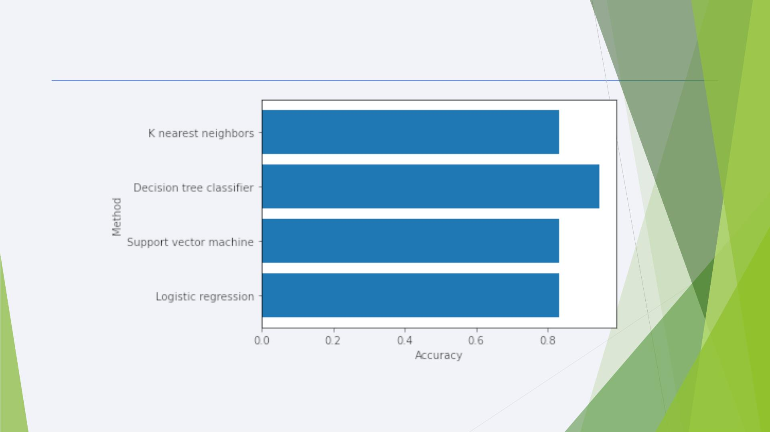
Classification Accuracy
From the graph and analysis from the notebook, The decision tree classifier yields the highest
43
accuracy

Slide 44
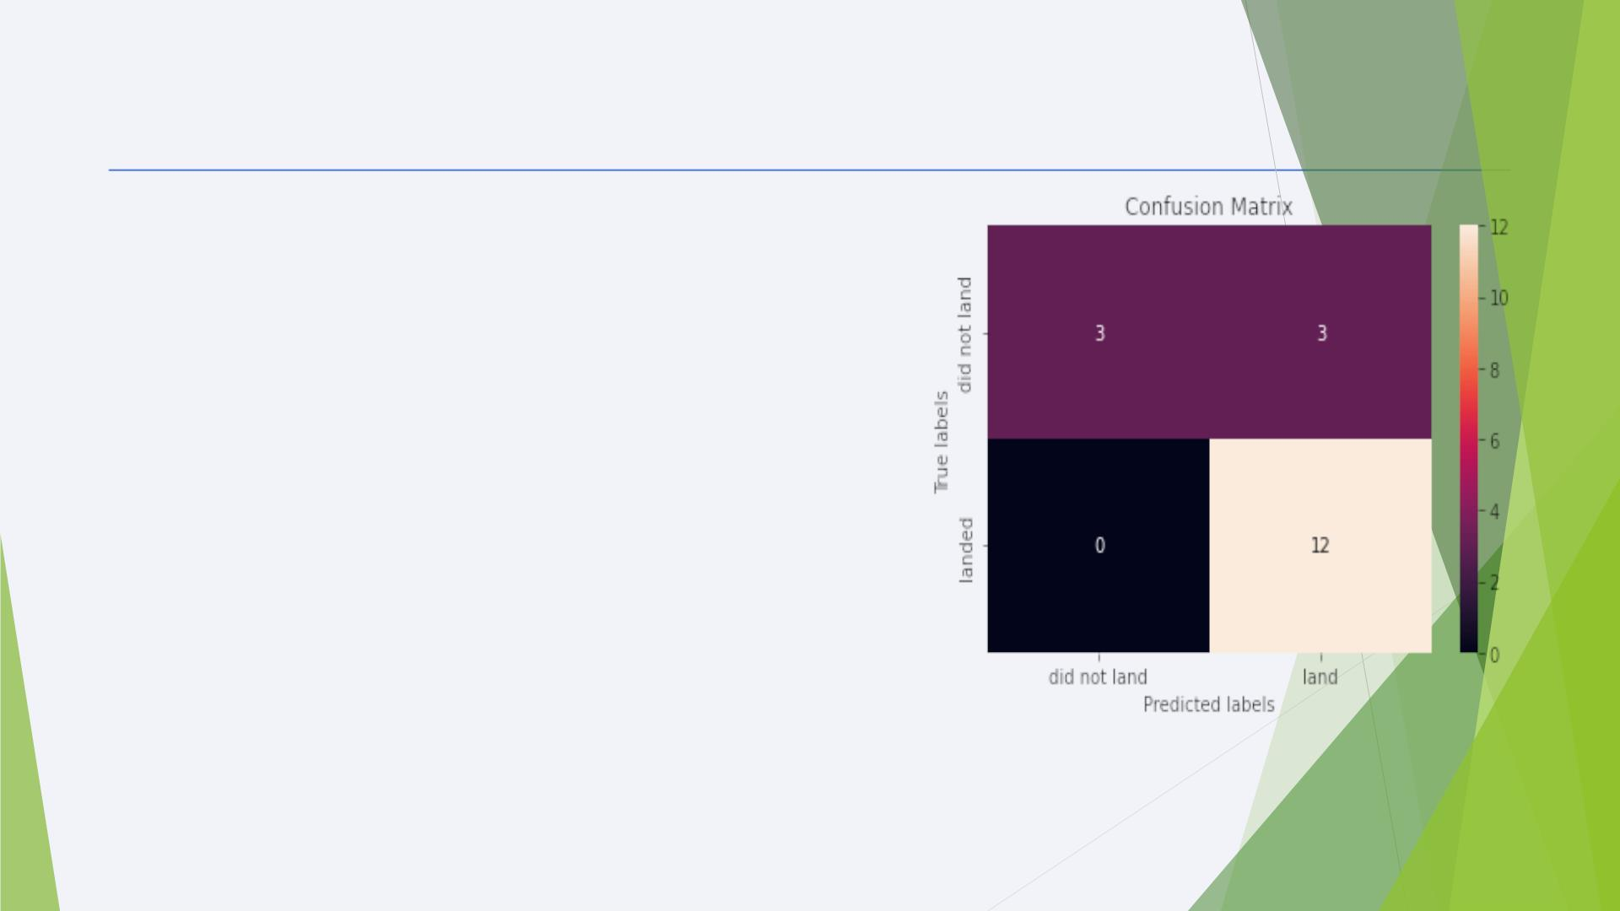
Confusion Matrix
• The model predicted 12 successful landings
when the True label was successful (True
Positive) and 3 unsuccessful landings when
the True label was failure (True Negative).
• The model also predicted 3 successful
landings when the True label was
unsuccessful landing (False Positive).
• The model generally predicted successful
landings.
44

Slide 45
Conclusions
We can conclude that:
◆ The larger the flight amount at a launch site, the greater the success rate at a launch site.
◆ Launch success rate started to increase in 2013 till 2020.
◆ Orbits ES-L1, GEO, HEO, SSO, VLEO had the most success rate.
◆ KSC LC-39A had the most successful launches of any sites.
◆ The Decision tree classifier is the best machine learning algorithm for this task.
45

Slide 46
References
◆ Fortune Business Insights (2020). Space launch services market.
https://www.fortunebusinessinsights.com/industry-reports/space-launch-services-market-101931
◆ CB Insights. The Top 12 Reasons Startups Fail. https://www.cbinsights.com/research/startup-failure-
reasons-top/
◆ IBM. Data Science Professional Certificate. https://www.coursera.org/professional-certificates/ibm-
data-science
◆ Space.com. SpaceX Lands Orbital Rocket Successfully in Historic First. https://www.space.com/31420
-spacex-rocket-landing-success.html
46

Slide 47
Appendix
◆ All notebooks and relevant materials used are in my github account.
Github URL: https://github.com/BERI-0094/IBM-CAPSTONE-PROJECT
47

Slide 48


